Slide 1


Market-Price
Prediction Model

Slide 2
1- Importing Libraries

Slide 3
2- Reading Data

Slide 4

3- Data Preprocessing:
1- Cleaning the dataset
2- Missing Values
3- Encoding categorical variables.

Slide 5
4- EDA: Exploratory Data Analysis
1- Analyzing the temporal patterns
2- Identifying seasonality
3- Trends
4- Anomalies

Slide 6
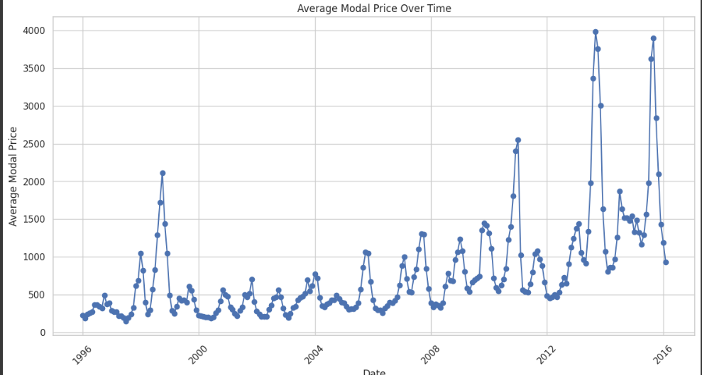
4- EDA: Exploratory Data Analysis

Slide 7
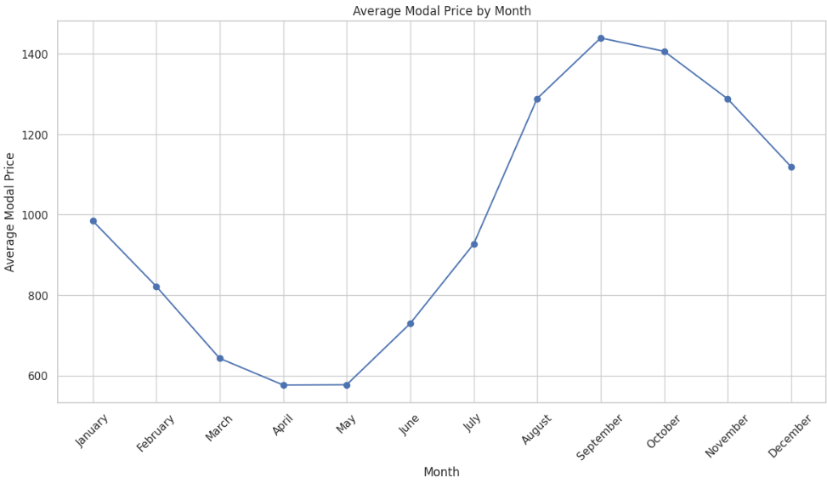
4- EDA: Exploratory Data Analysis

Slide 8
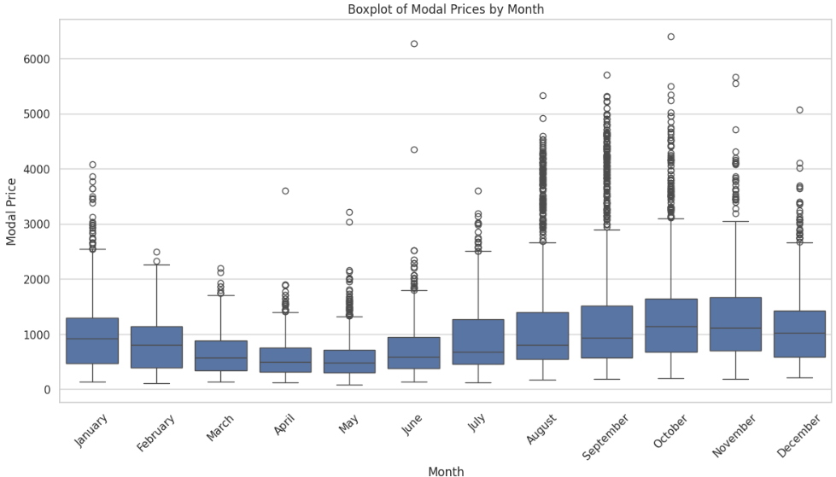
4- EDA: Exploratory Data Analysis

Slide 9
5- Feature Engineering
1- Lagged variables
2- Rolling statistics
3- Seasonal indicators

Slide 10
6- Model Selection, Training
and Evaluation :
1- ARIMA
2- SARIMA
3- Prophet
4- LSTM

Slide 11
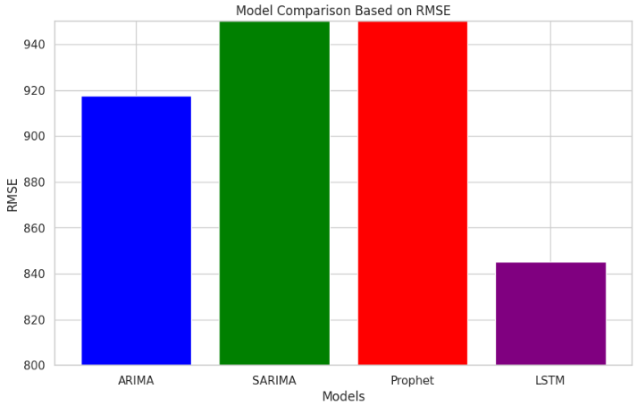
7- Model Selection and Training
and Evaluation :

Slide 12
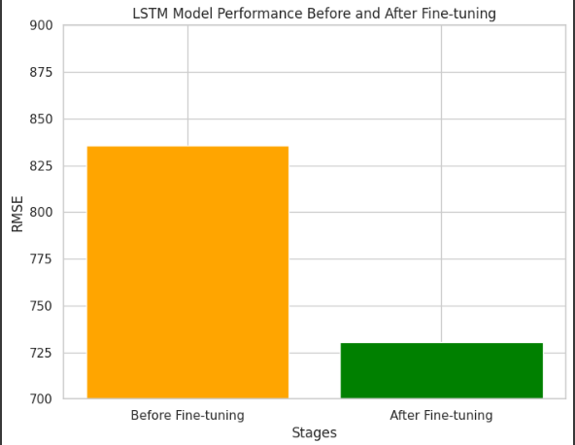
8- Fine-Tuning and Validation

Slide 13

Thanks

